Slide 1
Introduction to Machine learning

Slide 2
Why machine learning?
At a very high level, machine learning is the process of teaching a computer system how to make accurate predictions when fed data.
Develop systems that are automatically able to adapt to the environment, process the variables and produce results.
Mimic humans and replace them in monotonous task which require certain intelligence:
Recognizing hand writings

Slide 3
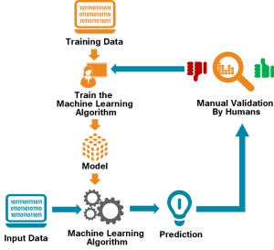
Machine learning model

Slide 4
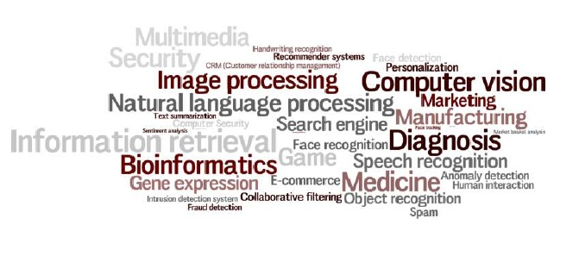
Applications of ML

Slide 5
Python
Python is a high-level, interpreted, general-purpose programming language. Created by Guido van Rossum and first released in 1991.
Python interpreters are available for many operating systems.
It supports a huge number of libraries solving a great deal of problems with greater ease.

Slide 6
Installing python
For Windows download the python installer from the www.python,org/downloads/windows
For MAC OS:
https://www.python.org/downloads/mac-osx/

Slide 7
Important python library
Numpy : pip install numpy
Matplotlib : pip install matplotlib
Pandas : pip install pandas
Scikit-learn : pip install scikit-learn

Slide 8
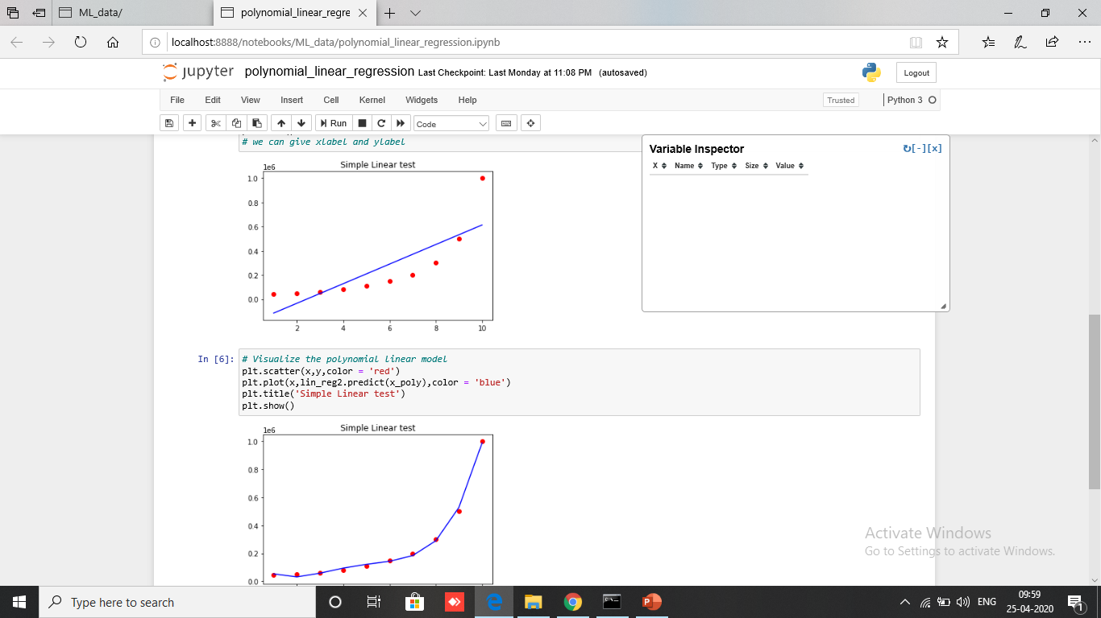
Jupyter notebook
The Jupyter Notebook is an open-source web application that allows you to create and share documents that contain live code, equations, visualizations and narrative text.
For now, you should know that "Jupyter" is a loose acronym meaning Julia, Python, and R. These programming languages were the first target languages of the Jupyter application.

Slide 9
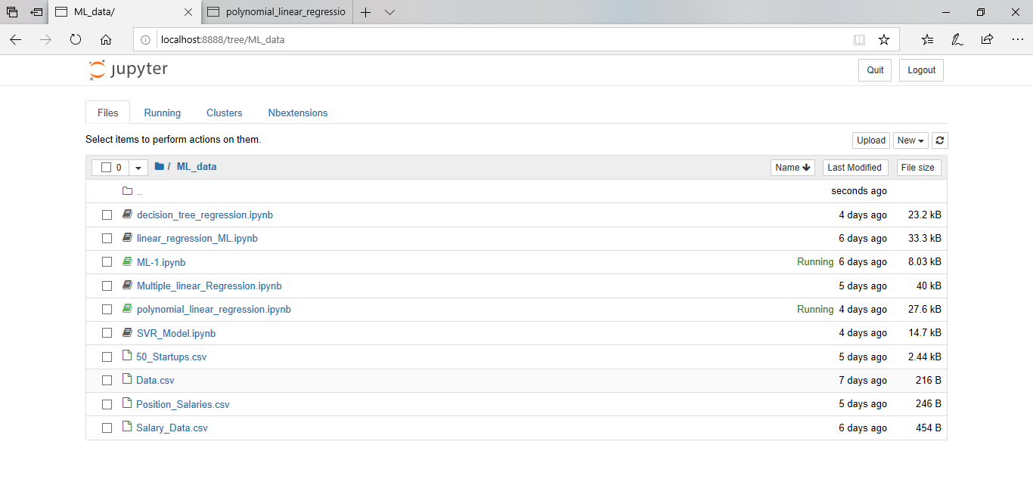
Installing jupyter notebook
pip3 install --upgrade pip
pip3 install jupyter
To run jupyter notebook:
Jupyter notebook

Slide 10
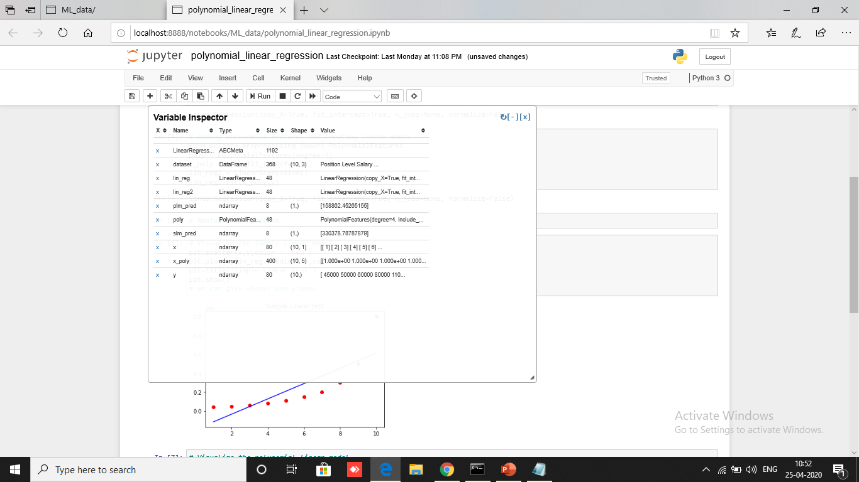
Adding variable inspector
pip install jupyter_contrib_nbextensions
jupyter contrib nbextension install –user
jupyter nbextension enable varInspector/main

Slide 11
Workbook in jupyter

Slide 12
Thank you

